Slide 1
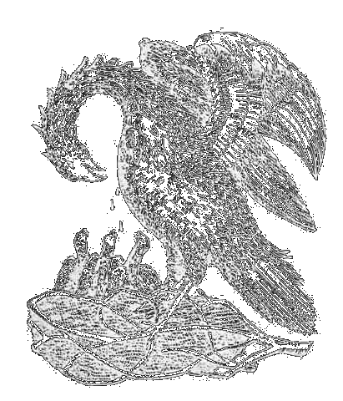


Cambridge University and the Natural approach to teaching Science
John Biggins... University of Cambridge

Slide 2

Who are Cambridge Teaching?
About 600 Natural Scientists per year
Mostly 18 years old
Top ~1.5% of the population
Already rather specialized – 4 A-levels
Broadly divided 50:50 between Physical and Biological Sciences

Slide 3
Natural Science…
4th Year: More Specialization
3rd Year: 1 Subject
2nd Year: 3 Subjects
1st Year: 4 Subjects

Slide 4
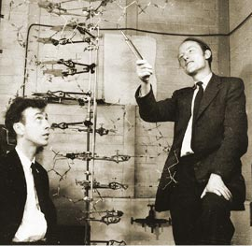
Why?
Old – First taught in 1849 – everything compulsory
Current form from the 1950’s,
Chemistry colliding with physics + biology – structure of DNA
Important developments to the “narrative of science” occurring in several fields – big bang vs steady state, DNA, start of plate tectonics…

Slide 5
Isn’t science really one subject anyway?

Slide 6

The first year
Biology of Cells
Chemistry
Computer Science
Geology
Evolution and Behaviour
Material and Mineral Science
Mathematics (3 types)
Physics
Physiology of Organisms

Slide 7

The second year
Animal Biology
Biochemistry and Molecular Biology
Cell and Developmental Biology
Chemistry (x2)
Ecology
Experimental Psychology
Geological Sciences (x2)
History and Philosophy of Science
Materials Science and Metallurgy
Mathematics
Mineral Sciences
Neurobiology
Pathology
Pharmacology
Physics (x2)
Physiology
Plant and Microbial Sciences

Slide 8


Third and fourth years
Astrophysics (+ 4th year)
Biochemistry (+ 4th year)
Chemistry (+ 4th year)
Genetics
Geological Sciences: (+ 4th year)
History and Philosophy of Science (+ 4th year)
Materials Science and Metallurgy (+ 4th year)
Neuroscience
Pathology
Pharmacology
Experimental and Theoretical Physics (+ 4th year)
Physiology, Development and Neuroscience
Plant Sciences
Psychology
Zoology

Slide 9
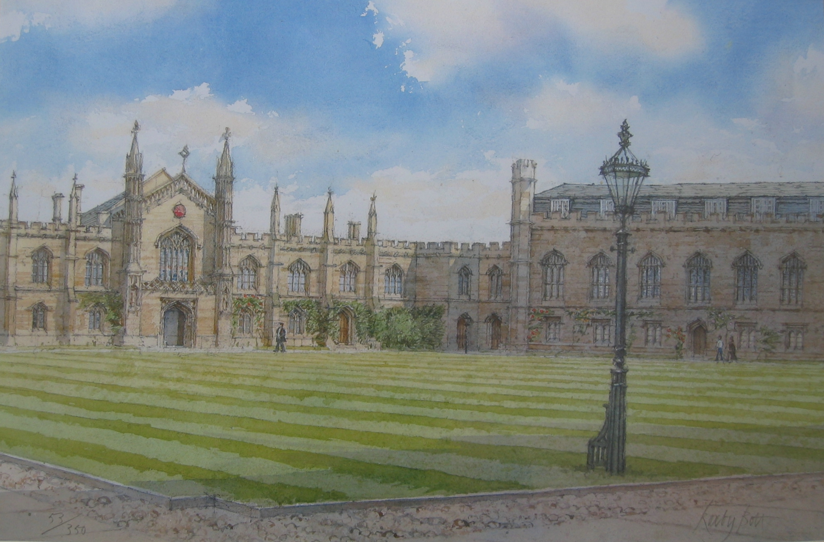
The Colleges

Slide 10
Students try to undermine it
Double subjects in the second year
Doesn’t link to other departments – engineering, maths, computer science
Sacrifice some content in your ultimate specialization
Everyone has some breadth
Enough specialization to think deeply and get very good at something
Strong group identity as scientists
Try before you buy
Specialization in non-school subjects
Produces successful researchers
Makes the subjects compete
_
+

Slide 11
Room for improvement?
Remove double second year options?
Remove “easy” maths for biologists?
Fewer options in the first + second year?
Compulsory maths in the 2nd year?
Computer science options?
Better integration with other triposes? Cambridge very much makes “Scientists”, “Engineers” and “Mathematicians” .

Slide 12
How much of their undergraduate education do researchers actually use?

Slide 13
1A Physics
1A Maths
Electromagnetism
Quantum Mechanics
1B Maths
Maths Methods
Thermodynamics
Statistical Physics
Classical Dynamics
Experimental Methods
Waves and Oscillations
Thermodynamics
Relativity and Electromagnetism
Advanced Quantum Mechanics
Theoretical Physics 1
Theoretical Physics 2
Astrophysics
Soft Matter physics
Particle physics
Condensed Matter Physics
Classical field theory (general relativity)
Condensed matter field theory
Quantum field theory
Gauge field theory
Information theory
Project
Phase transitions + critical phenomena

Slide 14
1A Physics
1A Maths
Electromagnetism
Quantum Mechanics
1B Maths
Maths Methods
Thermodynamics
Statistical Physics
Classical Dynamics
Experimental Methods
Waves and Oscillations
Thermodynamics
Relativity and Electromagnetism
Advanced Quantum Mechanics
Theoretical Physics 1
Theoretical Physics 2
Astrophysics
Soft Matter physics
Particle physics
Condensed Matter Physics
Classical field theory (general relativity)
Condensed matter field theory
Quantum field theory
Gauge field theory
Information theory
Project
Phase transitions + critical phenomena

Slide 15
Is this a communication problem?
Biologist
Chemist
Physicist
Geologist
Medic
Biologist
Chemist
Physicist
Geologist
Medic

Slide 16
Biologist
Chemist
Physicist
Geologist
Medic
Biologist
Chemist
Physicist
Geologist
Medic
?

Slide 17
Not everyone goes into research.

Slide 18
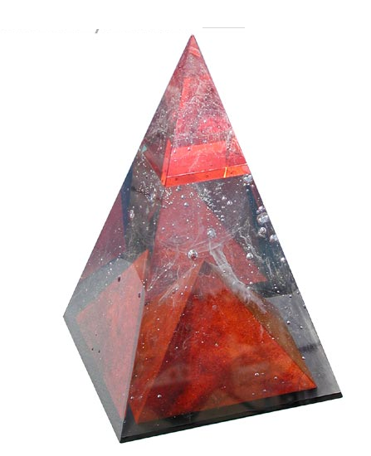
Last Points
Specialization + Breadth
Flexibility
Group identity
Its hard
I really enjoyed it

Slide 19
“I have been working with biologists for about ten years and now I am beginning to understand their questions.”
Theoretical physicist

Slide 20
“I am not a physicist, but I will try to explain this anyway, if I can.”
“I am not a biologist, but ….”
(Too often?) heard at conferences

Slide 21
“Education is one of the most difficult areas when talking to politicians. Everyone has an (expertise) opinion about it because they have all gone to school themselves.”
Expert on education
Politician(?)

Slide 22
What should universities produce?
Engineers?
Scientists?
Research results...?

Slide 23
Does cross-disciplinary research (biology/physics/medicine…) require cross-disciplinary/broad educational programs?

Slide 24
Broad educational programs –
“Little knowledge about a lot of things”
(Generalists)
Narrow educational programs –
“Expert on (a few) important things”
(Experts)

Slide 25
Could students with broader knowledge build bridges between researchers/groups from different disciplines?

Slide 26
What do (biotech) industry need?

Slide 27
Physics – Biology
Engineering - Medicine

Slide 28
“Can I take this course?”
“No, this is a physics program!”
Do/should we encourage students to look into other disciplines?
Do we allow students to change their direction/interests during their education?

Slide 29
Students:
What do you think about your educational programs?

Slide 30
Researchers:
What do you think about your own (undergraduate) education?

Slide 31
When to broaden/change your field(s) of research?
– when you start your PhD studies
– as a post-doc
– when you have become an expert in your first field
– don’t. Work with experts from other fields.

